Slide 1
“BIBLE LIFE” Study - Exploring the message & the ministry of Jesus Christ
Welcome to Friends & Family Fellowship – Sharing the vision
Navigation & Resources – Streaming, website, What’sapp
Introduction to the Bible Life Study– The Big idea!
Next steps?
GENESIS EVANGELICAL MISSION (GEM)

Slide 2
“BIBLE LIFE” Study - Exploring the message & the ministry of Jesus Christ
Introduction:
If you are looking for truth that can transform your life and change the world, devote yourself to diligent, disciplined study of God’s word.
Because a FAITH that is truly mature requires a MIND that is well informed.
“If you long to know the mind of God, you should first learn to use your own”.
GENESIS EVANGELICAL MISSION (GEM)
Notes:
Vision: 1. What is F3> Discipleship based teaching ministry. Why come to F3> A place to grow your faith and build friendships? How it integrates with other ministries and churches.

Slide 3
“BIBLE LIFE” Study - Exploring the message & the ministry of Jesus Christ
Vision:
1. What is F3? Discipleship based teaching ministry. From GYM to GEM!
2. Why come to F3? A place to grow your faith and build friendships through fellowship
3. How it integrates with other ministries and churches?
Bible life study group: Leadership through Discipleship
The chief purpose of this fellowship is to fill the gap between “knowing and understanding” God’s word.
The goal of this fellowship is simple. Provide biblical training that can deepen your understanding through study of basic principles of the Bible reading, studying and offer practical insights of living and loving like Jesus.
GENESIS EVANGELICAL MISSION (GEM)
Notes:
Our hope and prayer are that this course will help you in your journey of faith to sense your calling and to raise strong families because strong individuals make a strong family and strong families make a strong church.

Slide 4
“BIBLE LIFE” Study - Exploring the message & the ministry of Jesus Christ
10 Categories: (We will study one category each month)
1. Fear & Faith
2. Love & Lust
3. Life & Death
4. Light & Darkness
5. Kingdom & Church
6. Prayer & Worship
7. Law & Love
8. Religion & Relationship
9. Duty & Devotion
10. God & Man
Each Category will have “lessons to learn”
Perspective
Promise
Practice
Purpose
Principle
Homework- Study the Books!
Interaction – via What’s app
House visits – As needed
Evangelism – ??
GENESIS EVANGELICAL MISSION (GEM)

Slide 5
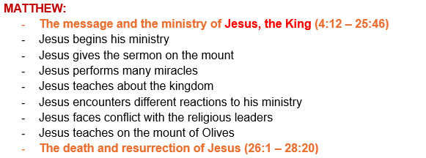
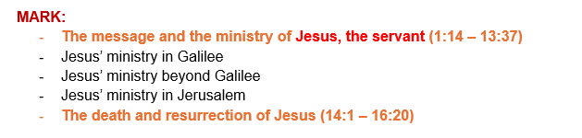
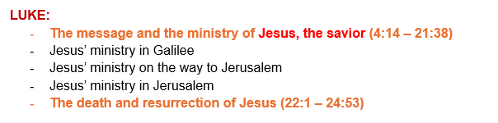
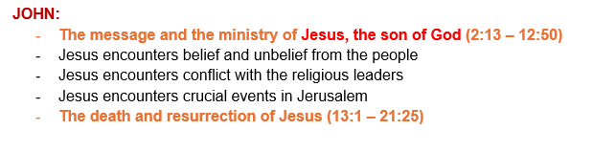
“BIBLE LIFE” Study - Exploring the message & the ministry of Jesus Christ
The Blueprint
Get to know the writers of the 4 Gospels
Matthew, the tax collector. Mark, a teenager, Luke, a physician and John the fisherman.
GENESIS EVANGELICAL MISSION (GEM)
Notes:
Focus on M&M vs Death & Resurrection of Jesus for each writer

Slide 6
“BIBLE LIFE” Study - Exploring the message & the ministry of Jesus Christ
Event | Approximate Date | Historical Context
Birth of Jesus | 6-4 BC | Jesus was born during the reign of King Herod the Great in Bethlehem, fulfilling the prophecies of the Old Testament about the Messiah's birthplace.
Baptism of Jesus | AD 26-28 | Jesus was baptized by John the Baptist in the Jordan River, marking the beginning of His public ministry. The Holy Spirit descended upon Him, and God declared Jesus His Son.
Temptation in the Wilderness | AD 26-28 | Jesus fasted for 40 days and nights in the desert, where Satan tempted him. He overcame these temptations and confidently began His ministry in His divine mission.
Ministry in Galilee | AD 27-29 | Jesus performed miracles, taught parables, and preached in synagogues throughout Galilee. He gathered His disciples, who followed Him and learned from His teachings.
Sermon on the Mount | AD 27-29 | Jesus delivered His most famous speech, outlining the Beatitudes, the Lord's Prayer, and other essential teachings that formed the foundation of Christian ethics and morality.
Ministry in Jerusalem | 29-30 | Jesus' ministry expanded to the city of Jerusalem, where He drew large crowds and came into conflict with the religious and political authorities of the time.
Last Supper | AD 30 | Jesus shared the Passover meal with His disciples, instituting the Eucharist and predicting His betrayal, trial, and crucifixion.
Crucifixion and Death | AD 30 | Jesus was arrested, tried, and crucified on a Roman cross as a criminal. He forgave His captors and died, fulfilling the prophecies of the Old Testament and offering Himself as a sacrifice for humanity's sins.
Resurrection and Ascension | AD 30 | Jesus was resurrected from the dead, on Easter Sunday, appearing to His disciples and many others. He then ascended to Heaven, leaving His followers with the Great Commission to share the Gospel.
GENESIS EVANGELICAL MISSION (GEM)
Notes:
Vision: 1. What is F3> Discipleship based teaching ministry. Why come to F3> A place to grow your faith and build friendships? How it integrates with other ministries and churches.

Slide 7
“BIBLE LIFE” Study - Exploring the message & the ministry of Jesus Christ
Why were they Gospels written?
The four gospels were not written for academic reasons. The apostles did not write them to make money. They were not seeking fame. The gospels were written so that we might know the truth.
Background – Christ’s life prior to His ministry
LUKE’S INTRODUCTION – Lk 1:1-4
- Reason for writing the Gospel
- The trustworthiness of the Gospel story
1. He had “…traced the course of all things accurately…” –vs. 3
2. Some refer to Luke as the first critic of Christianity.
3. This is because he did not accept man’s word but investigated on his own to find truth.
- The Incarnation of Christ
1. The Word became flesh and dwelt among us –Jn 1:14
GENESIS EVANGELICAL MISSION (GEM)
Notes:
Vision: 1. What is F3> Discipleship based teaching ministry. Why come to F3> A place to grow your faith and build friendships? How it integrates with other ministries and churches.

Slide 8
“BIBLE LIFE” Study - Exploring the message & the ministry of Jesus Christ
Books of New Testament
BOOK | AUTHOR | TIME OF WRITING | PLACE OF WRITING | AUDIENCE
JAMES | James | AD 40’s | Probably Jerusalem | Jewish Christians of the Dispersion
GALATIANS | Paul | AD 49, just after 1st missionary Journey | Antioch in Syria | Christians in Pisidian Antioch, Iconium, Derbe and Galatia
1st THESSALONIANS | Paul | AD 50-51, during 2nd missionary journey | Corinth | Christians in Thessalonica
2nd THESSALONIANS | Paul | AD 50-51, during 2nd missionary journey | Corinth | Christians in Thessalonica
1st CORTINTHIANS | Paul | AD 54, during 3rd missionary journey | Ephesus | Christians in Corinth
2ND CORINTHIANS | Paul | AD 55, during 3rd missionary journey | Macedonia | Christians in Corinth
ROMANS | Paul | AD 55, during 3rd missionary journey | Corinth | Christians in Rome
GENESIS EVANGELICAL MISSION (GEM)
Notes:
Vision: 1. What is F3> Discipleship based teaching ministry. Why come to F3> A place to grow your faith and build friendships? How it integrates with other ministries and churches.

Slide 9
“BIBLE LIFE” Study - Exploring the message & the ministry of Jesus Christ
Books of New Testament
BOOK | AUTHOR | TIME OF WRITING | PLACE OF WRITING | AUDIENCE
Mark | John Mark | Late 50’s or early 60’S | Rome | Non-Christian Romans; new converts
Philemon | Paul | 60 | Rome | Philemon, his family and the church at his house at Colosse
Colossians | Pal | 60 | Rome | Christians in Colosse
Ephesians | Paul | 60 | Rome | Christians in the region of Ephesus
Luke | Luke | 60 | Probably Caesarea or Rome | Non-Christian Roman official
Acts | Luke | 61 | Rome | Same as above (may be also to the new converts to Christianity)
Philippians | Paul | 61 | Rome | Christians in Philipi
1 Timothy | Paul | 62 | Macedonia | Timothy in Ephesus
Titus | Paul | 62 | Nicopolis | Titus in Crete
2 Timothy | Paul | 63 | Rome | Timothy in Ephesus
1 Peter | Peter | 63 | Rome | Christians in Asia Minor
2 Peter | Peter | 63-64 | Rome | Christians in Asia Minor
GENESIS EVANGELICAL MISSION (GEM)
Notes:
Vision: 1. What is F3> Discipleship based teaching ministry. Why come to F3> A place to grow your faith and build friendships? How it integrates with other ministries and churches.

Slide 10
“BIBLE LIFE” Study - Exploring the message & the ministry of Jesus Christ
Books of New Testament
BOOK | AUTHOR | TIME OF WRITING | PLACE OF WRITING | AUDIENCE
Matthew | Matthew | 60’s | Probably Antioch in Syria | Jews in Syria or Palestine
Hebrews | Unknown | 60’s | Unknown | Jewish Christians in Rome or Jerusalem
Jude | Jude | 60’s or 70’s | Unknown | Christians in general
John | John | Late 80’s or early 90’s | Ephesus | Christians and or non-Christians in the region around Ephesus
1 John | John | Late 80’s or early 90’s | Ephesus | Christians in the region around Ephesus
2 John | John | Late 80’s or early 90’s | Ephesus | A church near Ephesus
3 John | John | Late 80’s or early 90’s | Ephesus | Gaius, a Christian in the region around Ephesus
Revelation | John | Late 80’s or early 90’s | Patmos, off coast of Asia Minor | Seven churches in western Asia Minor
GENESIS EVANGELICAL MISSION (GEM)
Notes:
Vision: 1. What is F3> Discipleship based teaching ministry. Why come to F3> A place to grow your faith and build friendships? How it integrates with other ministries and churches.

Slide 11
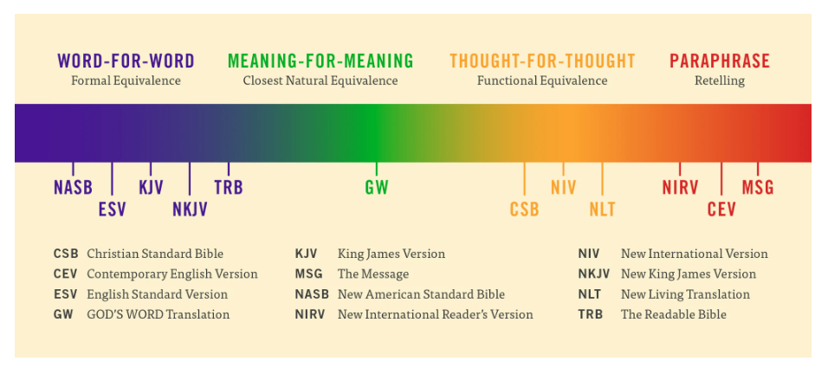
“BIBLE LIFE” Study - Exploring the message & the ministry of Jesus Christ
What’s the best bible translation?
Study
Read
1971
2001
1611
1982
1978
1996
Courtesy: God's word to the nations
GENESIS EVANGELICAL MISSION (GEM)
Notes:
Vision: 1. What is F3> Discipleship based teaching ministry. Why come to F3> A place to grow your faith and build friendships? How it integrates with other ministries and churches.

Slide 12
“BIBLE LIFE” Study - Exploring the message & the ministry of Jesus Christ
Four world empires contributed to the preparation for the coming of Jesus and for preaching of the Gospel
1. Babylonian Contribution: THE GREAT DISPERSION:
The Babylonians attacked Israel and took them into captivity on three occasions, 606, 597, and 586 B.C. This resulted in the dispersion of the Jews throughout Babylon, Asia Minor, Egypt, and parts of Media.
2. Medo-Persian Contribution: THE GREAT CIVIL LAW MAKER:
The Medes and Persians established an enforced civil law that had to be followed by both the common man and the king himself,
3. Grecian Contribution: THE GREAT CULTURE AND LANGUAGE GIVER:
Alexander the Great came from Greece and conquered most of the then civilized world. With him he brought the Greek culture, refinement and education, and the Greek language. Having a singular written dynamic language enabled people to communicate more easily over wide areas.
4. Roman Contribution: THE GREAT BUILDER AND LAW ENFORCER
They made a number of contributions which enabled the preaching of the gospel to be more easily spread. They built roads to travel on (many of these were begun by the Medes and Persians), and they made it safe to travel
GENESIS EVANGELICAL MISSION (GEM)
Notes:
Vision: 1. What is F3> Discipleship based teaching ministry. Why come to F3> A place to grow your faith and build friendships? How it integrates with other ministries and churches.

Slide 13
“BIBLE LIFE” Study - Exploring the message & the ministry of Jesus Christ
What was the logic behind the Scripture cannon (standard)?
1. Is it prophetic?
Was the book written by a prophet of God? Were the authors Apostles or Prophets? God put His words in the mouths of the prophets and they declared what God had revealed to them. Therefore, books written by a prophet were immediately accepted.
2. Is it miraculous?
Was the writer given God’s affirmation through signs, fulfillment of prophecy, or
comparison to other truth revealed up to that point?
3. Is it authentic?
Does the message speak the truth about God?
4. Is it dynamic?
Does it manifest the power of God? The word of God is able to accomplish its stated
purpose.
5. Is it received?
Was it accepted by the people of God?
GENESIS EVANGELICAL MISSION (GEM)
Notes:
Vision: 1. What is F3> Discipleship based teaching ministry. Why come to F3> A place to grow your faith and build friendships? How it integrates with other ministries and churches.

Slide 14
“BIBLE LIFE” Study - Exploring the message & the ministry of Jesus Christ
Seeing Jesus, Knowing God!
Because Jesus was God in the flesh, and because the gospels tell His story, they tell us volumes about God. Here are some examples of what Christ's life, death, and resurrection tell us about God.
- In Jesus' birth, we see the mercy of God as He humbled Himself to come to our rescue
(Matt. 1:21-23).
- In Jesus' teaching, we see the wisdom and goodness of God as He tells us what to believe and how to live (John 12:49, 50).
- In Jesus' miracles, we see the unlimited power of God to control nature, disease, and death (Mark 4:35-41; Luke 7:11-18; 9:37-42).
- In Jesus' training of the Twelve, we see God's desire to work through His people
(John 14:12).
- In Jesus' death, we see how far God would go to redeem us from our sins
(John 3:16).
- In Jesus' resurrection, we see the supernatural power of God to conquer death
(Mark 16:1-8).
GENESIS EVANGELICAL MISSION (GEM)

Slide 15
“BIBLE LIFE” Study - Exploring the message & the ministry of Jesus Christ
Why is it important to study the life and ministry of Jesus?
The life of Christ reveals that Jesus was and is God because of His miracles, wonders, teachings, His very unusual life, His crucifixion, resurrection and ascension back to heaven.
The life of Christ is like none other. By studying the life of Jesus, we gain insights into the culture, history and worldview of those hearing His message and carrying that message to the world.
It further validates prophetic teachings and statements of His claim to be the Messiah.
2. How can you we grow spiritually and help others come into a relationship with Jesus?
In our efforts to teach the gospel we must be careful not to convert someone to the
Church but rather to teach them to become disciples of Jesus. Our role is to
teach. The Holy Spirit will add them to the church.
This doesn’t lessen the importance of the church but puts the focus of our teaching on Jesus our Savior.
When we do this, we grow spiritually. Spiritual maturity is seen in how we are more and more like Jesus.
"But when the fullness of time had come, God sent forth His Son, born of a woman,
born under the law," Galatians 4:4
GENESIS EVANGELICAL MISSION (GEM)
Notes:
Vision: 1. What is F3> Discipleship based teaching ministry. Why come to F3> A place to grow your faith and build friendships? How it integrates with other ministries and churches.

Slide 16
“BIBLE LIFE” Study - Exploring the message & the ministry of Jesus Christ
Scripture repeatedly teaches that Jesus was completely God and completely man
He does not have two natures living in one body. He is not half God and half man.
Scripture assumes we understand that He is completely man and completely God. Scripture never assumes He is half, quarter or a piece of God and/or man but that Jesus is totally and completely both.
Jesus was totally and inseparably both God and man. It is important to know that Jesus was not 50% God and 50% man.
GENESIS EVANGELICAL MISSION (GEM)
Notes:
Vision: 1. What is F3> Discipleship based teaching ministry. Why come to F3> A place to grow your faith and build friendships? How it integrates with other ministries and churches.

Slide 17
“BIBLE LIFE” Study - Exploring the message & the ministry of Jesus Christ
Jesus is Christ!
Acts 18:5 When Silas and Timothy had come from Macedonia, Paul was compelled by the Spirit and testified to the Jews that Jesus is the Christ.
Jesus (savior) Christ (Lord)
The statement “Jesus is Lord” means that Jesus is God.
If Jesus is Lord, then He has the right to tell us what to do.
Jesus is Lord of all.
If someone confesses “Jesus is Lord” but doesn’t actually submit to his “power and authority,” they are contradicting themselves.
The soul that is touched by the Jesus, will be taught by Christ
We are SAVED from – condemnation and power of sin
And SAVED to Serve show forth His riches
GENESIS EVANGELICAL MISSION (GEM)

Slide 18
“BIBLE LIFE” Study - Exploring the message & the ministry of Jesus Christ
Jesus:
He is Lord of our thoughts
He is Lord of our priorities
He is Lord of our desires
He is Lord of our speech
He is Lord of our prayers
He is Lord of our relationships
He is Lord of our resources
He is Lord of our temples (bodies)
He is Lord of our Labor
Lord of our Service
GENESIS EVANGELICAL MISSION (GEM)

Slide 19
“BIBLE LIFE” Study - Exploring the message & the ministry of Jesus Christ
GENESIS EVANGELICAL MISSION (GEM)

Slide 20
“BIBLE LIFE” Study - Exploring the message & the ministry of Jesus Christ
GENESIS EVANGELICAL MISSION (GEM)
Notes:
Vision: 1. What is F3> Discipleship based teaching ministry. Why come to F3> A place to grow your faith and build friendships? How it integrates with other ministries and churches.

